Slide 1
Variable Types 101
Visual Basic 6

Slide 2
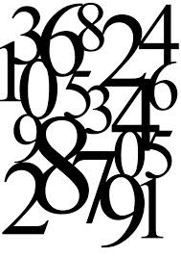
Integer
Whole numbers
Range : -32,768 to +32,767
a 16-bit number
should be used when you are working with values that can not contain fractional numbers
Syntax:
Dim i As Integer

Slide 3
Long
Whole numbers
Range : -2,147,483,648 to +2,147,483,647
Visual Basic does not recognize numbers with commas in expressions
Examples are the population of a city, the distance between places of different countries, the number of words of a book
Syntax:
Dim WorldPopulation As Long

Slide 4
Single
Decimal numbers and whole numbers
Range : -3.402823E38 to -1.401298E-45 for negative numbers and 1.401298E-45 to 3.402823E38 for positive numbers
a 32-bit number
When you need fractional numbers within this range, this is the data type to use
Syntax:
Dim AvgHeight As Single

Slide 5
Double
Decimal numbers and whole numbers
The Double data type is a 64-bit floating point number used when high accuracy is needed.
These variables can range from -1.79769313486232e308 to -4.94065645841247e-324 for negative values and from 4.94065645841247e-324 to 1.79769313486232e308 for positive values.
Syntax:
Dim PreciseRatio As Double

Slide 6


Currency
Dollar amounts
Singles can also be used, but in the conversion from decimal to binary and back, round-off error can occur
Syntax:
Dim GrossPay As Currency

Slide 7

String
Syntax: Dim Word1 As String
usually used as a variable-length type
A variable-length string can contain up to approximately 2 billion characters
Each character has a value ranging from 0 to 255 based on the ASCII character set
Strings are used when Text is involved.
Characters including:
Text
Special characters such as the pound sign(#), the underscore (_), and the tilde(~)
Digits, 0-9
A set of characters contained in double quotes is called a string literal or string
Two types of variables to hold strings:
Fixed-length string variables hold only the number of characters you specify
Variable-length string variables can hold strings up to about 65,000 characters long

Slide 8
Variant
A Variant can be used to declare any kind of variable. You can use a variant when you can't make up your mind regarding a variable but, as a beginning programmer, you should avoid it
Syntax:
Dim FlexValue As Variant

Slide 9
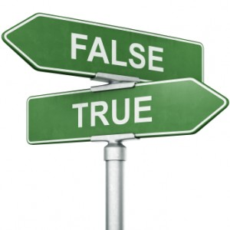
Boolean
The Boolean data type has only two states, True and False.
These types of variables are stored as 16-bit (2 Byte) numbers
usually used for flags.
Syntax: Dim IsOperable As Boolean

Slide 10

Date
To declare a variable that can hold either date values, time values, or both, use the Date keyword. After the variable has been declared, you will configure it to the appropriate value.
Syntax:
Dim DateofBirth As Date

Slide 11
Byte
A byte is a small natural positive number that ranges from 0 to 255.
can be used to hold small values such as a person's age, the number of fingers on an animal, etc.
Syntax:
Dim StudentAge As Byte

Slide 12
User-Defined
User-defined Types (UDTs) are VB's way of implementing data structures. In C/C++, they are called structs, in Pascal and COBOL they are called records (they are also called "group" items in COBOL).
The following rules apply to UDTs:
UDTs may be declared only at the module-level (you may not declare a UDT in an individual Sub or Function)
UDTs may have Public (project-level) or Private (module-level) scope. If the keyword Public or Private is omitted, the default is Public.
UDTs with Public scope may only be defined in standard modules, not forms.
The syntax for defining a UDT is:
[Public | Private] Type TypeName
Variable1 As datatype
...
Variablen As datatype
End Type

Slide 13
Resources
http://www.rentron.com/datatypes.htm
http://www.functionx.com/vb6/Lesson04.htm
http://visualbasic.freetutes.com/learn-vb6/lesson2.html

